Slide 1


Huazhong University of Science and Technology
The Department of Electronics and Information Engineering
Electronic Circuit Analysis and Design
Dr. Tianping Deng
Email: dengtp@hust.edu.cn

Slide 2
Contents
PART 1 SEMICONDUCTOR DEVICES AND BASIC APPLICATIONS
Chapter 1 Semiconductor Materials and Diodes
Chapter 2 Diode Circuits
Chapter 3 The Field-Effect Transistor
Chapter 4 Basic FET Amplifiers
Chapter 5 The Bipolar Junction Transistor
Chapter 6 Basic BJT Amplifiers
Chapter 7 Frequency Response
Chapter 8 Output Stages and Power Amplifiers
PART 2 ANALOG ELECTRONICS
Chapter 9 Ideal Operational Amplifiers and Op-Amp Circuits
Chapter 10 Integrated Circuit Biasing and Active Loads
Chapter 11 Differential and Multistage Amplifiers
Chapter 12 Feedback and Stability
Chapter 13 Operational Amplifier Circuits
Chapter 14 Nonideal Effects in Operational Amplifier Circuits
Chapter 15 Applications and Design of Integrated Circuits
Chapter 6 Basic BJT Amplifiers

Slide 3
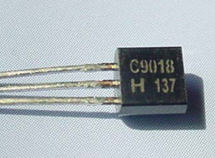
Ch6. Basic BJT Amplifiers
6.0 Preview
6.1 Analog Signals and Linear Amplifiers
6.2 The Bipolar Linear Amplifier
6.3 Basic Transistor Amplifier Configurations
6.4 Common-Emitter Amplifiers
6.5 AC Load Line Analysis
6.6 Common-Collector (Emitter-Follower) Amplifier
6.7 Common-Base Amplifier
6.8 The Three Basic Amplifiers: Summary and Comparison
6.9 Multistage Amplifiers
6.10 Power Considerations
6.11 Design Application
6.12 Summary

Slide 4
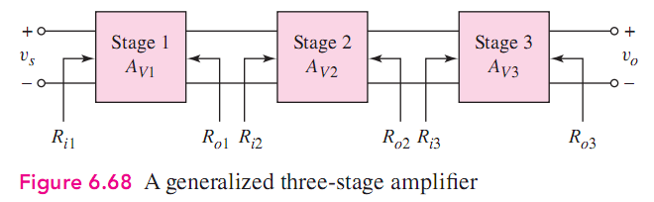
6.9 Multistage Amplifiers
(1) The Reason of Using Multistage Circuit
A single transistor amplifier will not be able to meet the combined specifications of a given amplification factor, input resistance, and output resistance.
(2) Cascade Configuration
3 circuits are connected in series, or cascaded. Each circuit can be CE, CC, or CB configuration

Slide 5
6.9 Multistage Amplifiers
(3) Loading effect
E.g. R_{i2} is the load of stage 1.
R_{i2} = R_{L1}
R_{o1} = R_{S2}

Slide 6
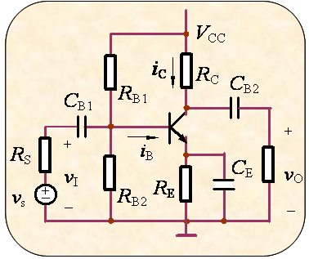
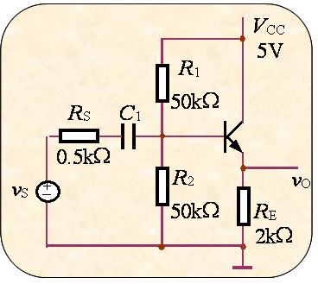
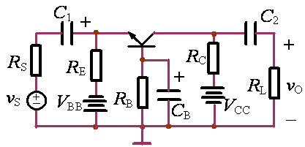
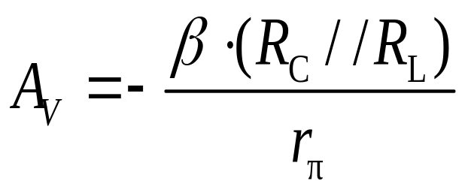
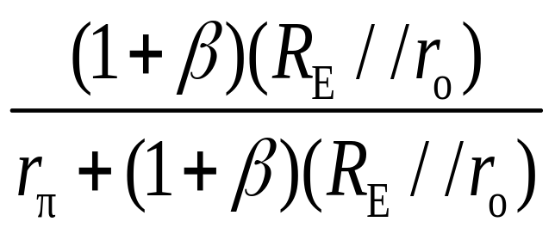
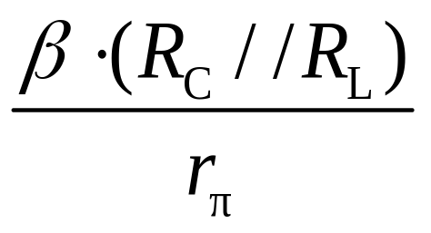
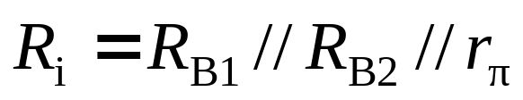
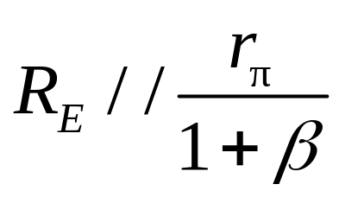

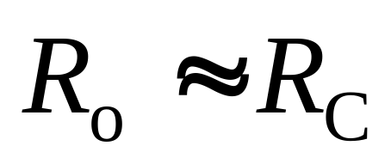
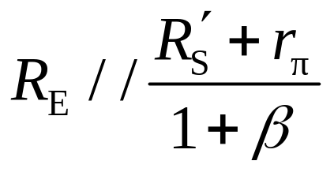
6.8 The Three Basic Amplifier: Summary and Comparison
Large
Small
Small

Slide 7
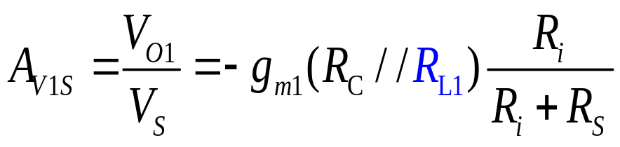
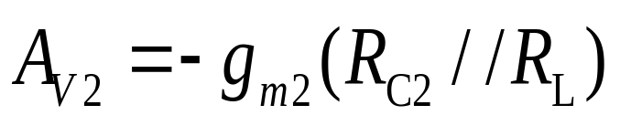
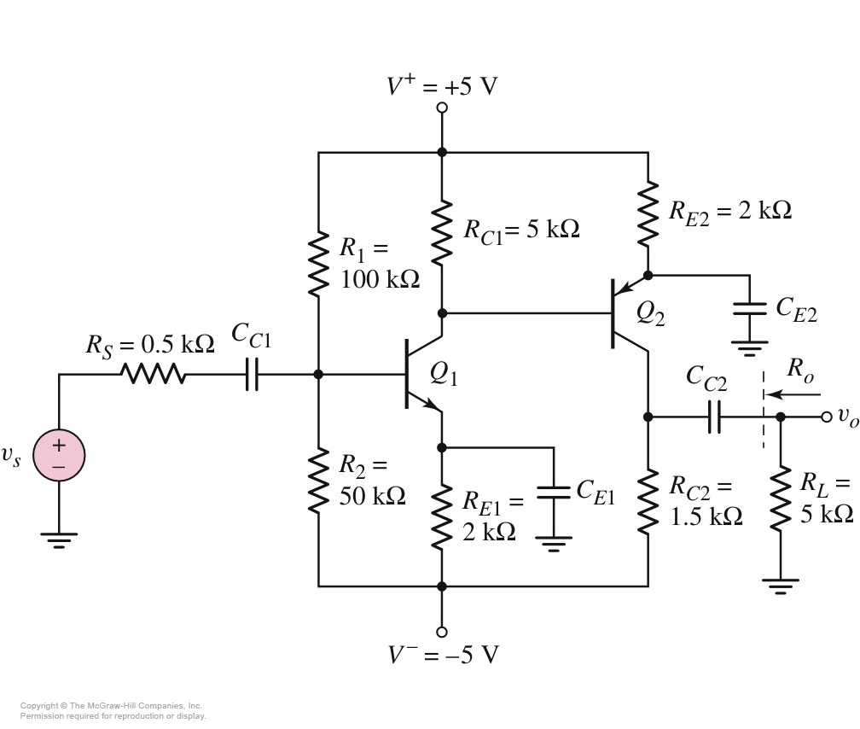
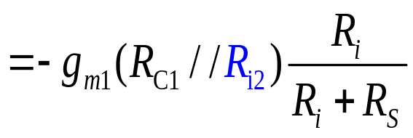
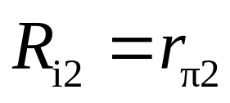
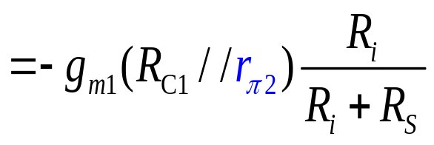


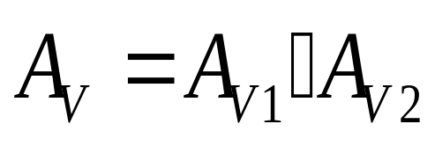

6.9 Multistage Amplifiers
6.9.1 Multistage Analysis: Cascade Configuration
CE
CE

Slide 8
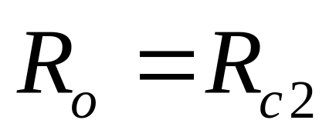

6.9 Multistage Amplifiers
6.9.1 Multistage Analysis: Cascade Configuration

Slide 9
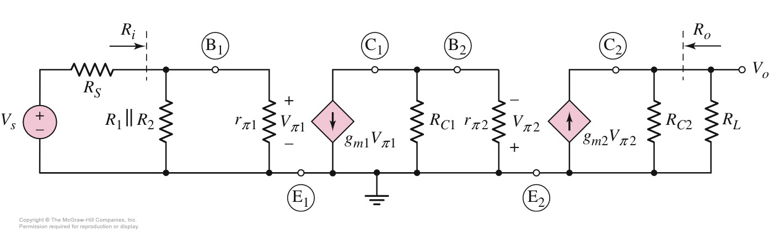
6.9 Multistage Amplifiers
6.9.1 Multistage Analysis: Cascade Configuration
Sketch small-signal
circuit

Slide 10
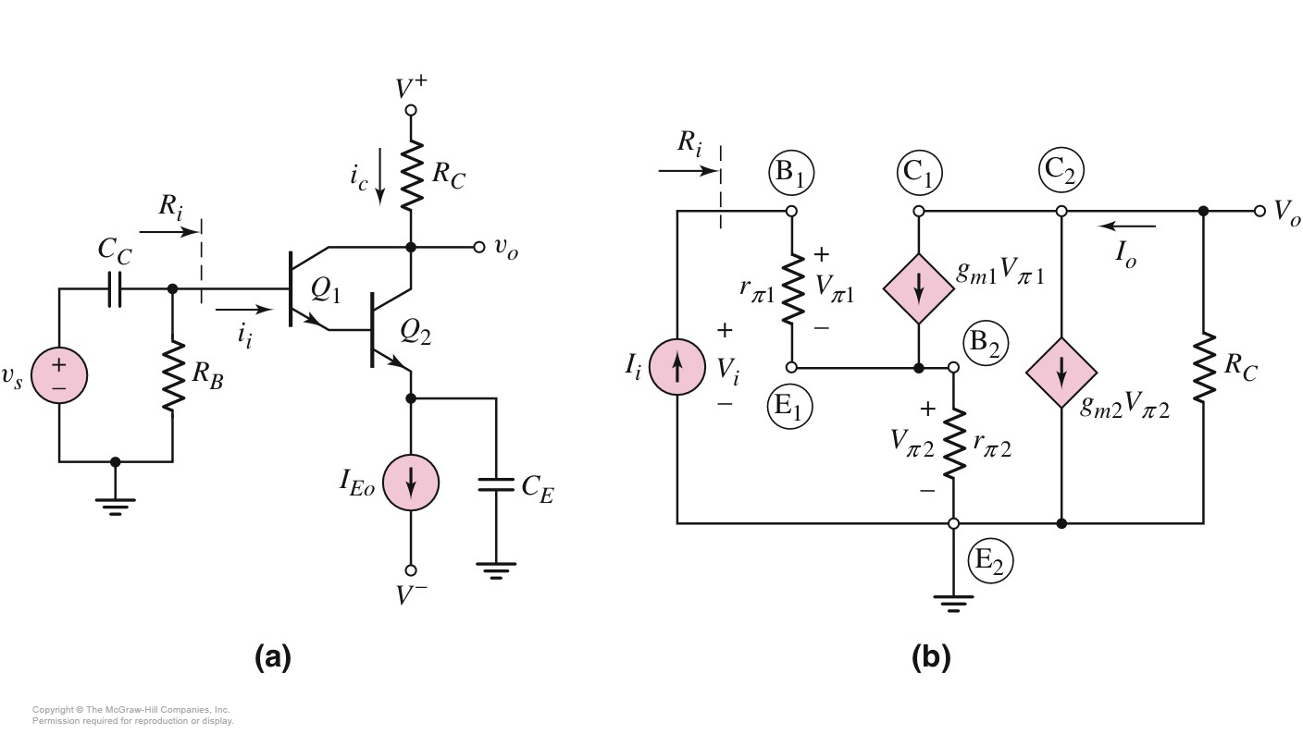
6.9 Multistage Amplifiers
6.9.2 Multistage Circuit: Darlington Pair Configuration
CC
CE

Slide 11
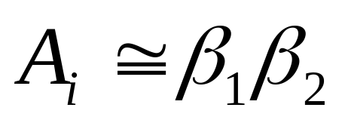




6.9 Multistage Amplifiers
6.9.2 Multistage Circuit: Darlington Pair Configuration

Slide 12

6.9 Multistage Amplifiers
6.9.2 Multistage Circuit: Darlington Pair Configuration

Slide 13
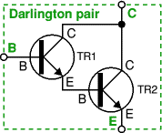
6.9 Multistage Amplifiers
6.9.2 Multistage Circuit: Darlington Pair Configuration
A Darlington pair behaves like a single transistor
with a very high current gain

Slide 14
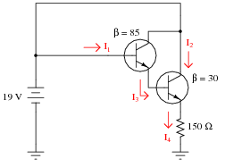
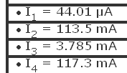
6.9 Multistage Amplifiers
6.9.2 Multistage Circuit: Darlington Pair Configuration
Calculate all labeled currents in this Darlington pair circuit, for all transistors, assuming V_{BE}=0.7 V

Slide 15
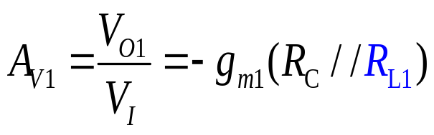
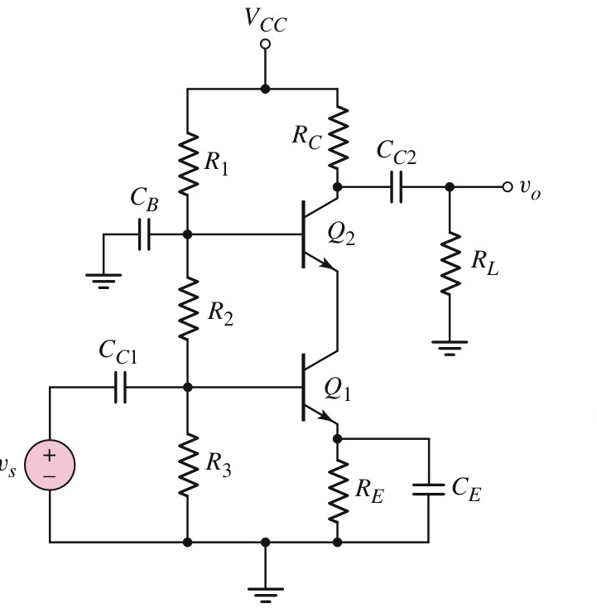
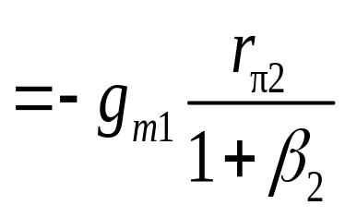
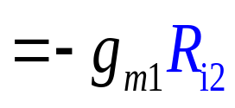

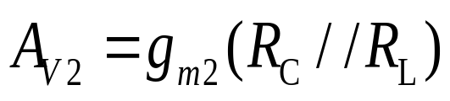
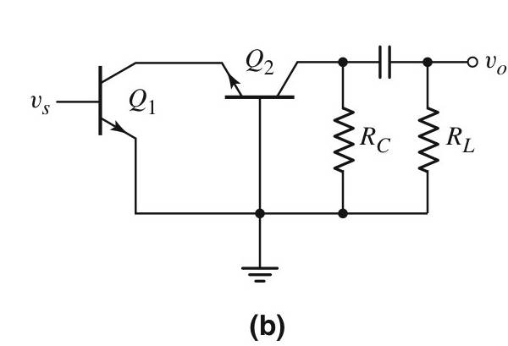

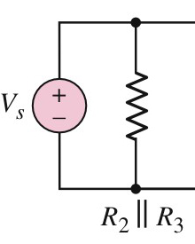
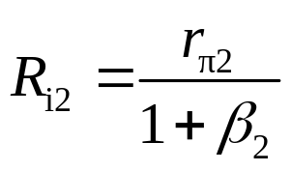
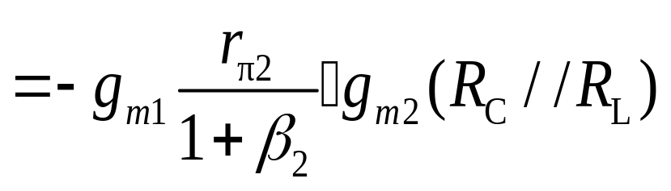
6.9 Multistage Amplifiers
6.9.3 Multistage Circuit: Cascode Configuration
AC Circuit
CB
CE

Slide 16


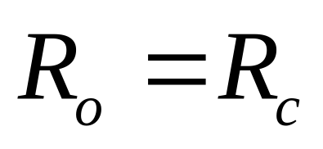

6.9 Multistage Amplifiers
6.9.3 Multistage Circuit: Cascode Configuration

Slide 17
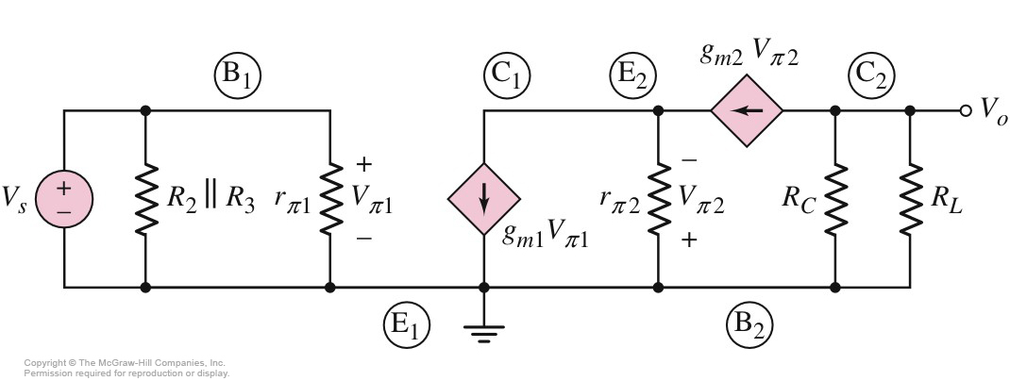
6.9 Multistage Amplifiers
6.9.3 Multistage Circuit: Cascode Configuration

Slide 18
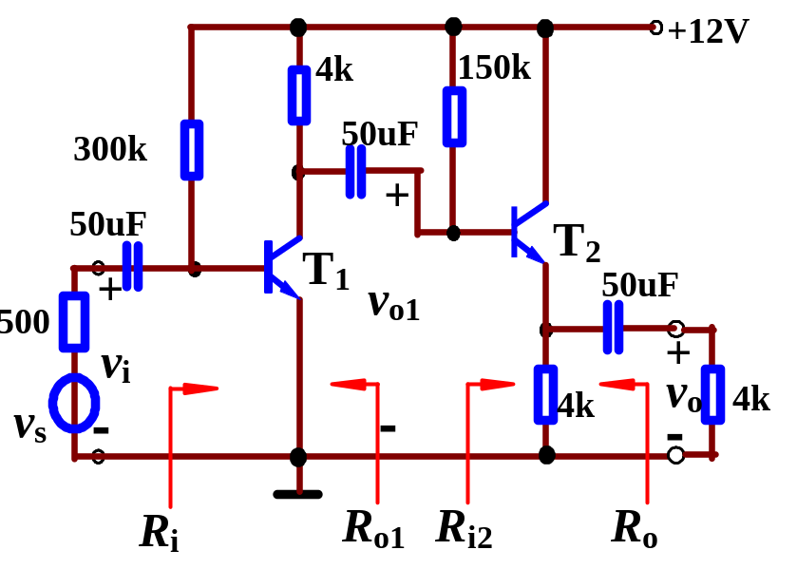
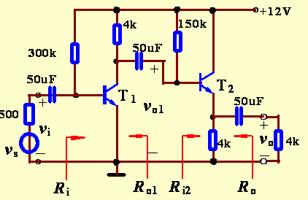

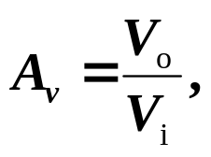

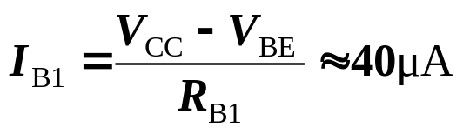

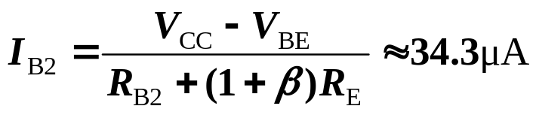
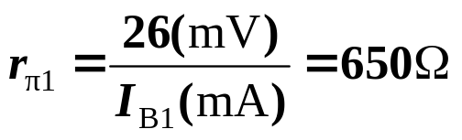

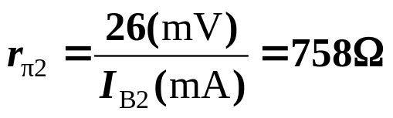
Example 2
Find
β=50.
Sol:
(1) Find the Q-point values
(2) Determine small-signal parameters

Slide 19


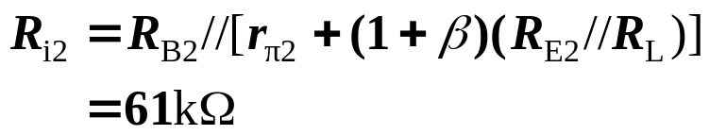
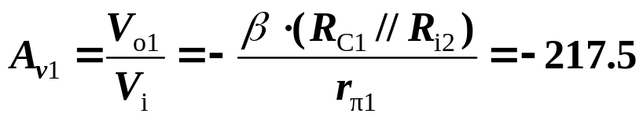
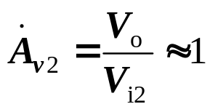
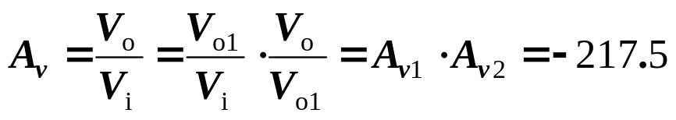







2. Multistage Amplifiers
(3) Find voltage gain
(4) Determine input and output resistances

Slide 20
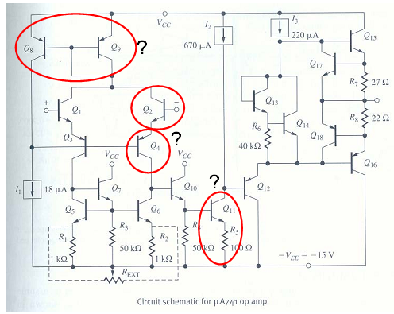
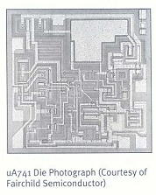

Slide 21
Questions
and
Answers

